Slide 1
to the English period

Slide 2
PHUOC VINH AN PRIMARY SCHOOL
Unit 9: WHAT’S THE FASTEST ANIMAL IN THE WORLD?
Lesson 3
Speaking and WRITING
Teacher: Trần Dư An

Slide 3
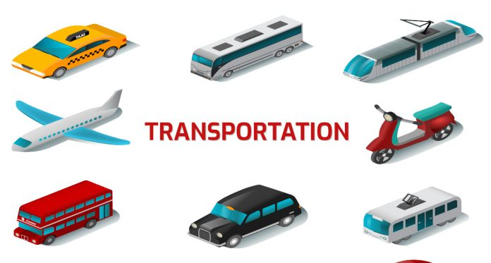
Unit 9: Lesson 3

Slide 4
Unit 9: Lesson 3
Cheetar

Slide 5
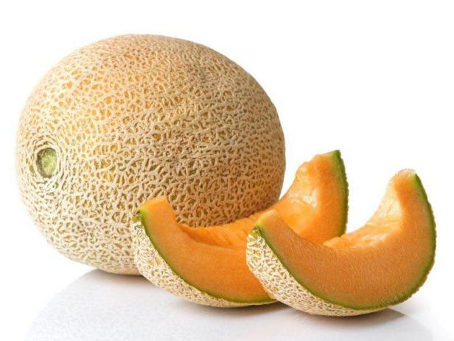
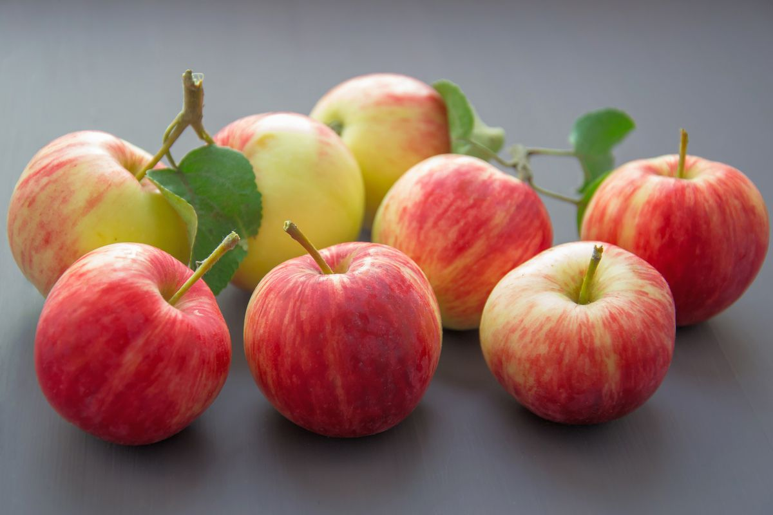
Unit 9: Lesson 3
Big
Bigger
The biggest

Slide 6
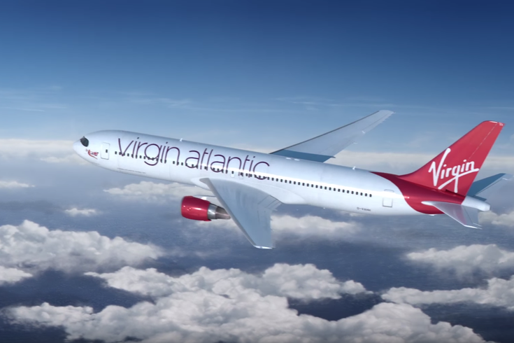
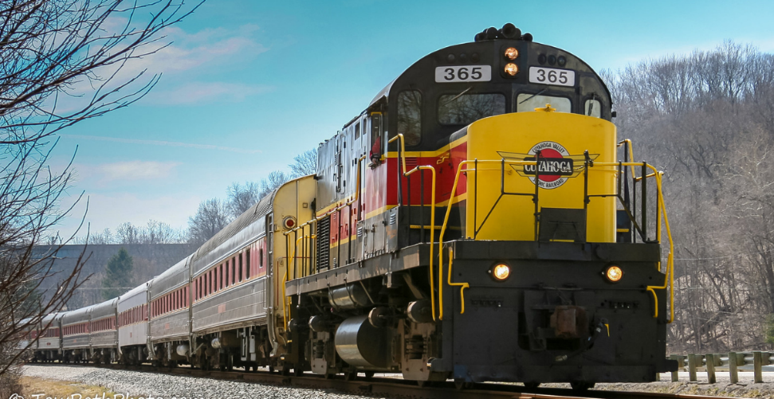
Unit 9: Lesson 3
Fast
Faster
The fastest

Slide 7
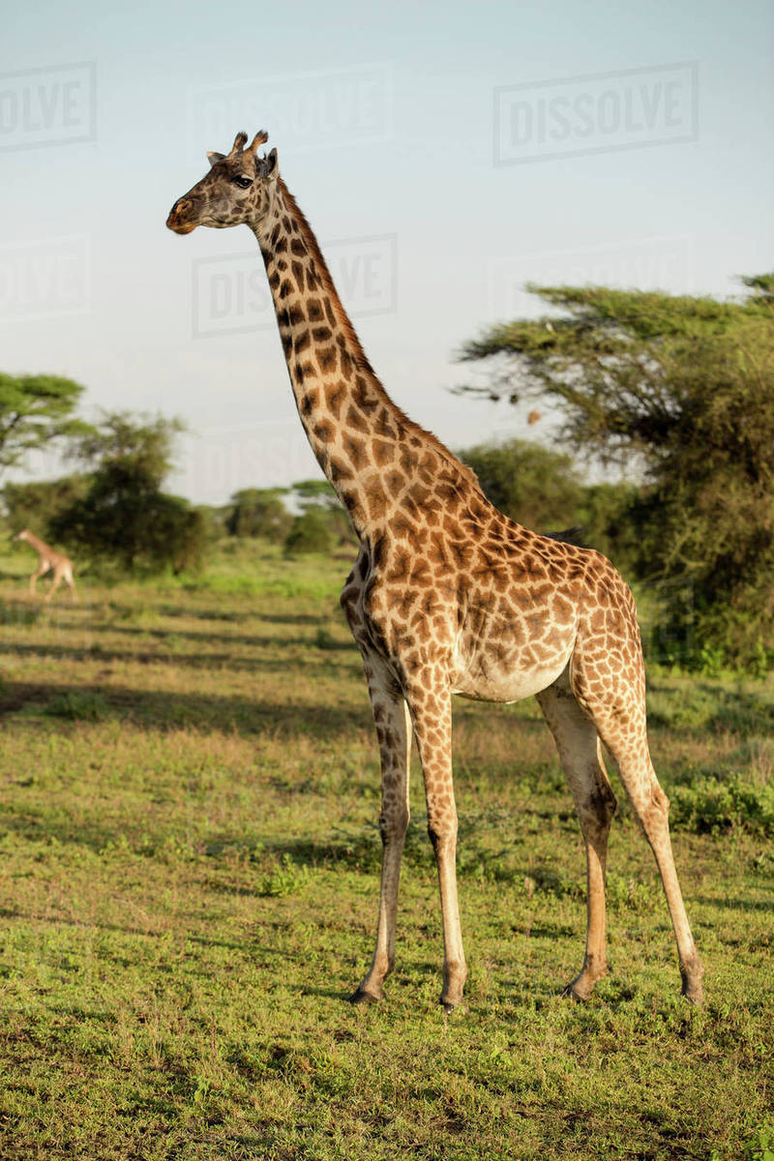
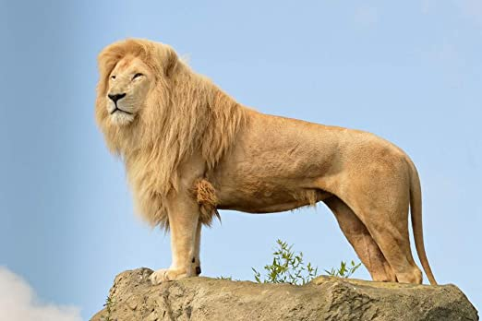
Unit 9: Lesson 3
Tall
Taller
The tallest

Slide 8
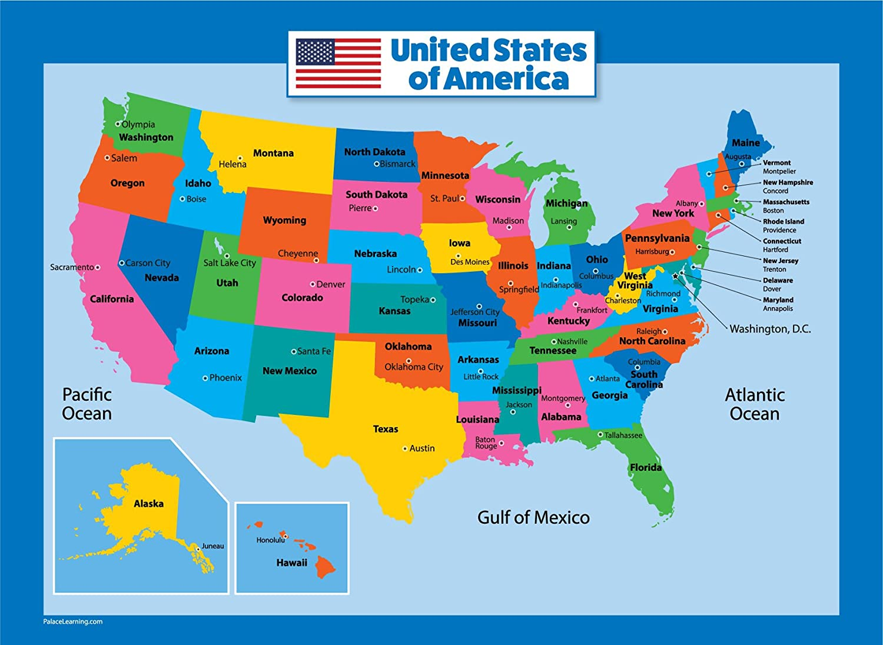
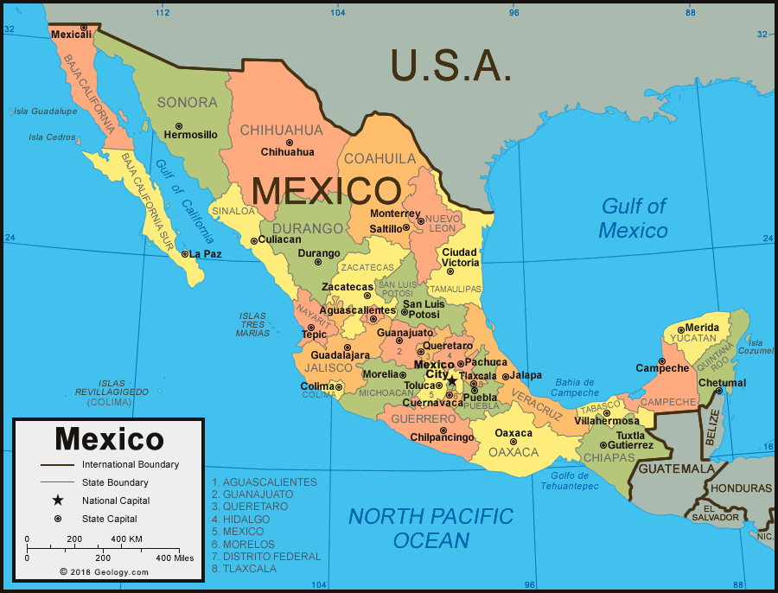
Unit 9: Lesson 3
The
smallest
small
smaller

Slide 9
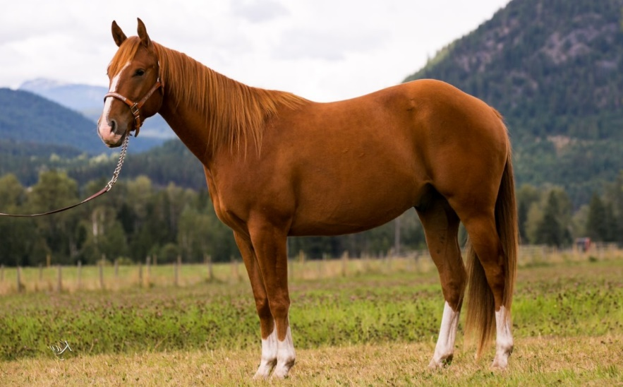
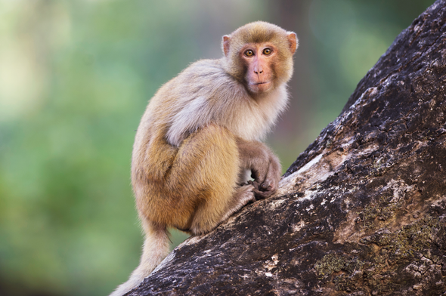
Unit 9: Lesson 3
The
slowest
slow
slower

Slide 10
Unit 9: Lesson 3

Slide 11
Unit 9: Lesson 3
Đáp án 1: Ask and answer.
Biggest fruit?: What’s the biggest fruit? – A melon
Fastest transportation?: What’s the fastest transportation? – A plane
Tallest animal?: What’s the tallest animal? – A giraffe
Smallest country?: What’s the smallest country? – Viet Nam
Slowest animal?: What’s the slowest animal? – A monkey

Slide 12
Unit 9: Lesson 3
Đáp án 2: Write three sentences.
The biggest fruit is a melon.
The fastest transportation is a plane.
The tallest animal is a giraffe.
The smallest country is Viet Nam.
The slowest animal is a monkey.

Slide 13
Unit 9: Lesson 3

